Slide 1
Digilent Design Contest 2019 Sign Language Letter Translator
Umut Toksoy
Zahit Karaçam

Slide 2
Outline
Sign Language
The Role of FPGA In this Project
Sign Language Letter Translator

Slide 3
Sign Language
Definiton of Sign Language: A language that employs signs made with the hands and other movements, including facial expressions and postures of the body, used primarily by people who are deaf. Approximately 70 Million deaf people around the world use sign language.
Using sign language in daily life for deaf people might be difficult. Also learning process is difficult for healthy people.

Slide 4
The Role of FPGA In this Project
The first purpose of this project is trying to find a solution for sign language users.
Instead of using microcontrollers, we have decided to do it using an FPGA. As a beginner, we want to develop ourself in this area and be a part of it.

Slide 5
This project might be developed by using microcontrollers. There are a lot of projects that is trying find a solution for sign language problems by using microcontrollers. However, there is no approach like this project using an FPGA.

Slide 6
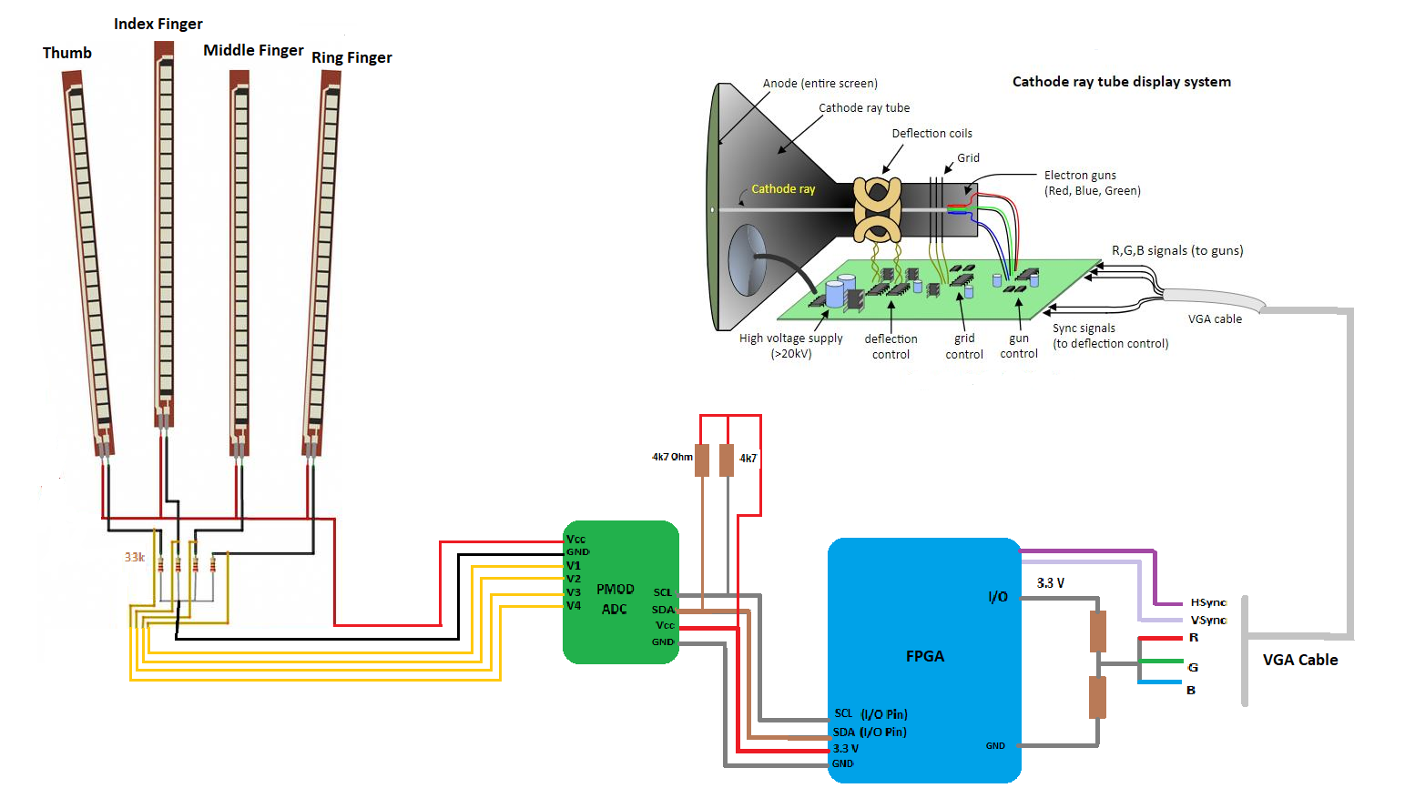
Sign Language Letter Translator
The general view of project is:

Slide 7
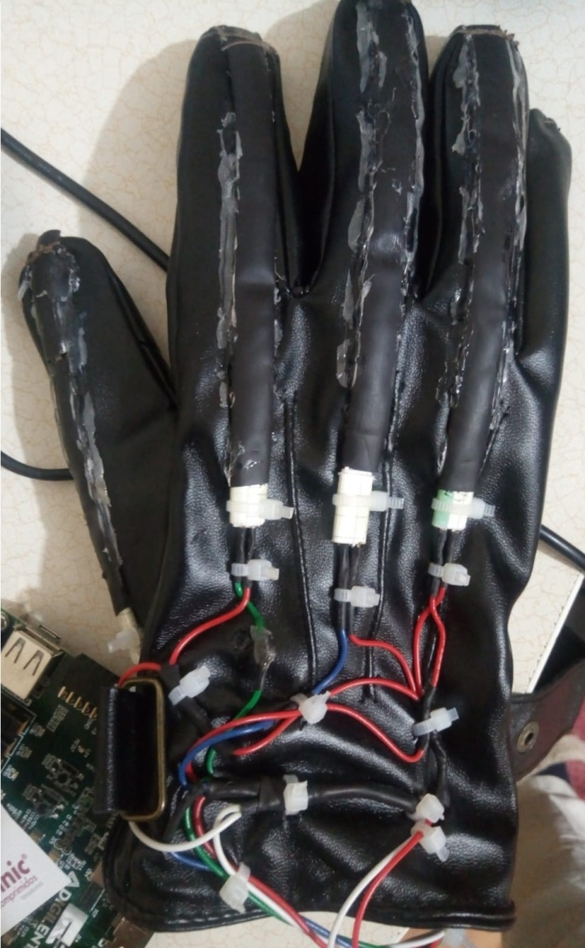
The project consist of a glove that has 4 flex sensors to dedect gestures.

Slide 8
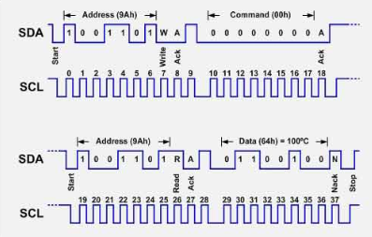
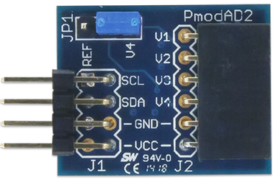
The PMOD AD2 is used to convert analog signals coming from sensors to digital signals. It uses I2C communication protocol.

Slide 9
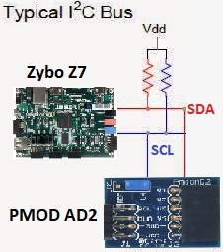
The PMOD then sends these digital signals to ZYBO. Using Vivado, a VHDL code is written for I2C and dealing with digital signals.

Slide 10
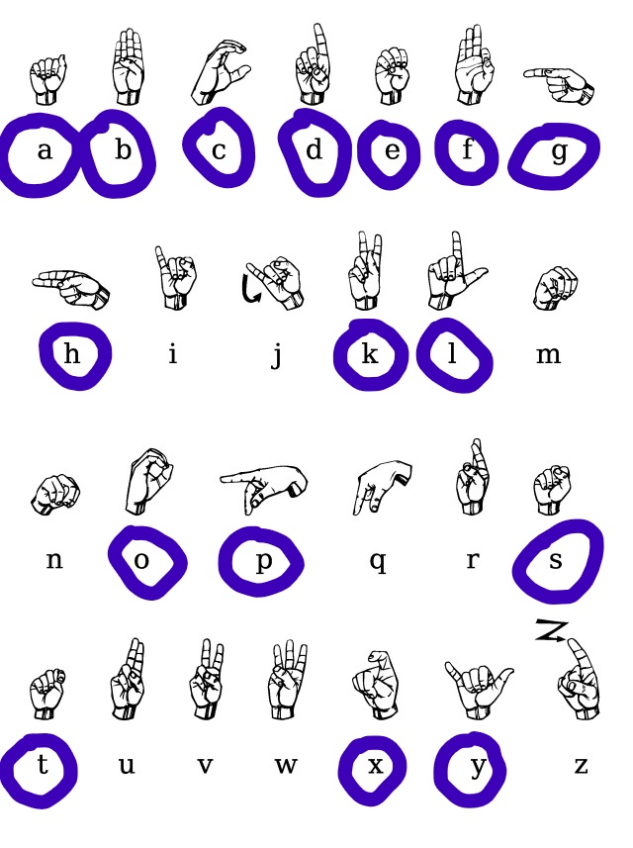
Then FPGA use these digital signals in order to decide which letter or gesture is performing.
The 16 letters that our device can convert are :

Slide 11
ZYBO decides the letters using if-else statements.
Above in VHDL part, p1-p4 represent 4 fingers. Also we can see the letter on ZYBO in binary form using 4 LEDs. «kontrol_ledleri» represents these LEDs. «gelen_harf» keeps the data of which letter is performed. It is used for driving the performed letter on VGA monitor.

Slide 12
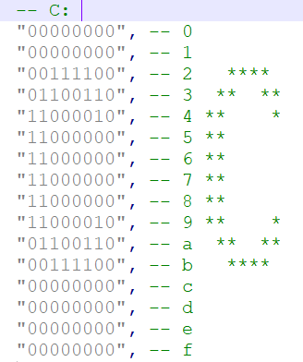
These letters then will be visualized on VGA monitor.
Before driving the VGA monitor, the letters are implemented on VHDL as can be seen below. The letters are based on ASCII characters.
In this project the capital letters are used.

Slide 13
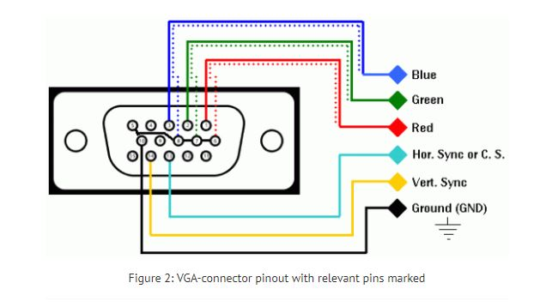
There are 5 important pins coming out from the ZYBO to drive the VGA monitor. R,G,B, VSYNC and HSYNC. These are for color arrangements and positioning arrangements. These signals are transfered using gpio pins to the monitor with VGA cable .

Slide 14
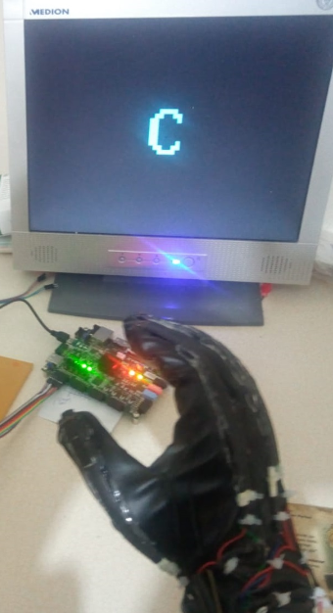
Lastly the letter will be shown on the screen. As an an example letter C is represented.

Slide 15
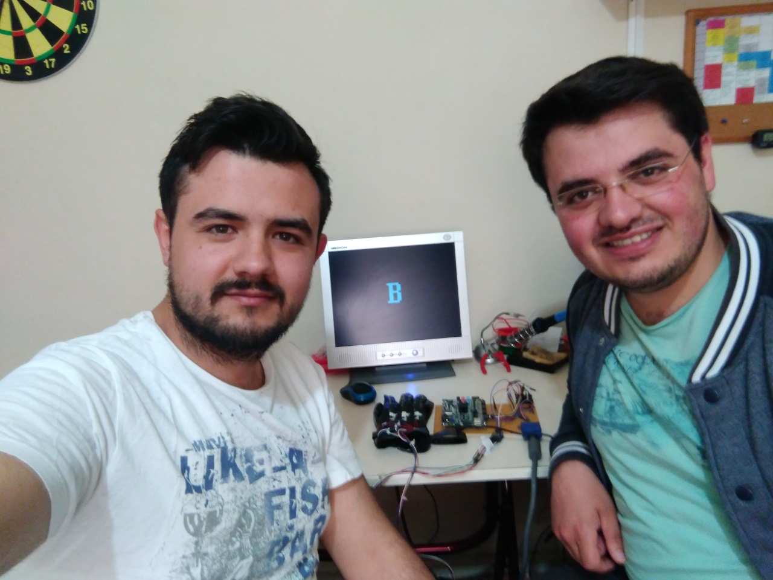
THANK you FOR LISTENING

